Slide 1
An Analysis of Claims Denial Patterns and their Association with Dis-enrollment
Does a higher claim denial rate lead to higher dis-enrollment

Slide 2
Introduction And Motivation
Before starting this project, I discussed potential business challenges with my manager.
Key areas identified included improving operational processes, identifying trends, and reducing the cost of care due to reworks.
Claim denials were highlighted as an important factor, as incorrect denials can increase costs and require rework.
Due to HIPAA regulations, detailed cost data is limited, so this analysis focuses on publicly available plan-level data.
Health insurance plans process millions of claims each year, and a portion of these claims are denied.
Claim denials may affect patient experience and satisfaction. Understanding whether denial rates influence consumer behavior can provide insight into how individuals respond to plan performance.
Research question: Does a higher claim denial rate lead to higher disenrollment?

Slide 3
Dataset Overview
Source: CMS Transparency in Coverage (2023)
Sheet Used: Transparency 2023 – Ind QHP
Unit of Analysis: Each row represents a health insurance plan
Size:
~6,000 plans
30+ variables
Key Variables Used:
Plan_Number_Claims_Received,
Plan_Number_Claims_Denied
Average Monthly Enrollment
Average Monthly Disenrollment
Includes additional information on: Appeals and Denial reasons Plan characteristics (e.g., metal level)
Dataset Source: Sourced from Healthcare.gov transparency in coverage PUFs, 2023 - https://data.healthcare.gov/datasets?fulltext=transparency%20in%20coverage

Slide 4
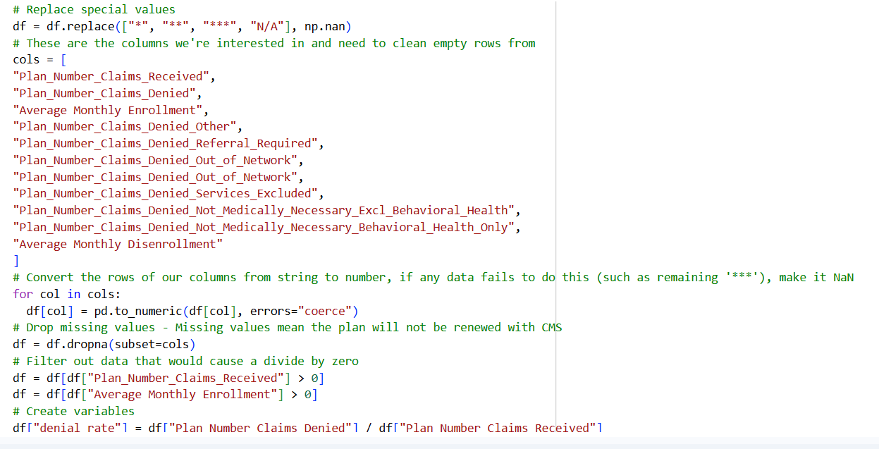
Methodology
Data Cleaning
We use the second sheet of the dataset, “Transparency 2023 – Ind QHP.”
To prepare the data for analysis:
Replaced special values (e.g., *, N/A) with NAN (not a number)
Converted relevant columns to numeric format
Removed rows with missing or incomplete data
Filtered out invalid entries (e.g., zero values that could cause division errors)
Focused on plan-level variables related to claims and enrollment

Slide 5
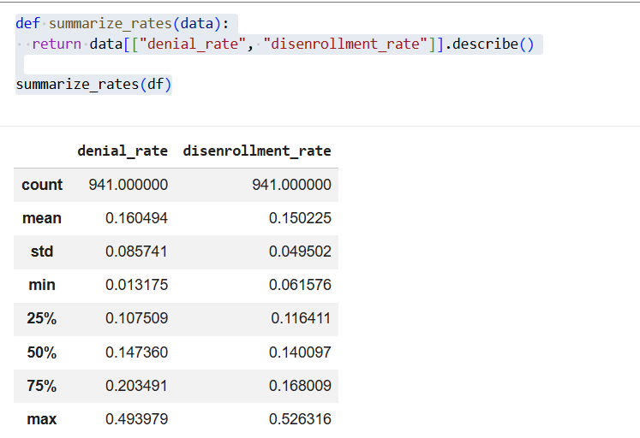
Summary Function

Slide 6
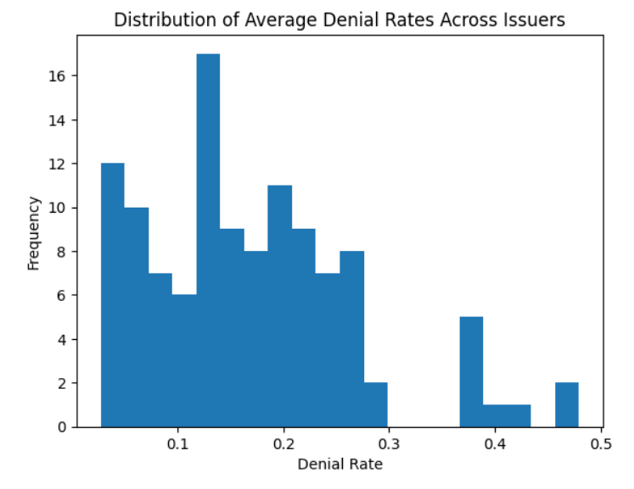
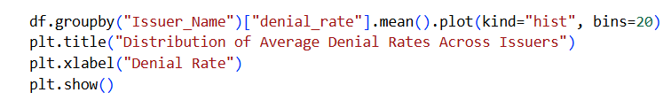
Data Visualization
Figure 1
This histogram shows the distribution of average denial rates across issuers.
Most issuers have denial rates between approximately 10% and 25%, with fewer issuers at very high denial rates.

Slide 7
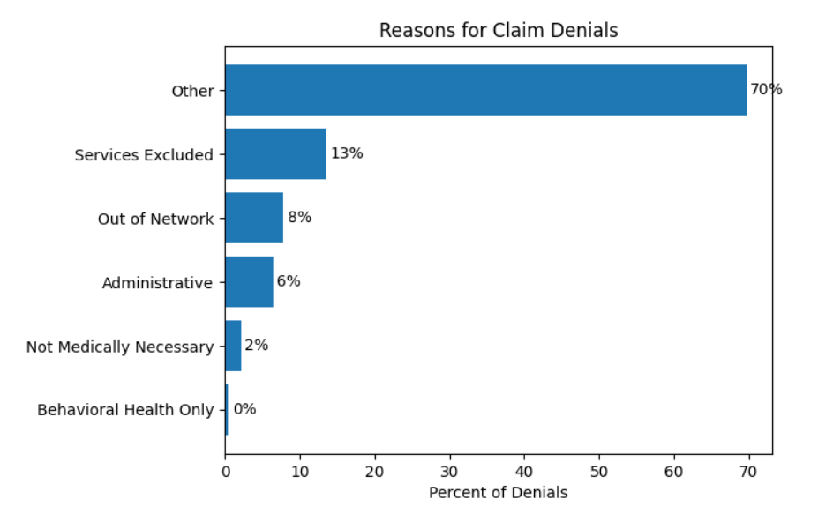
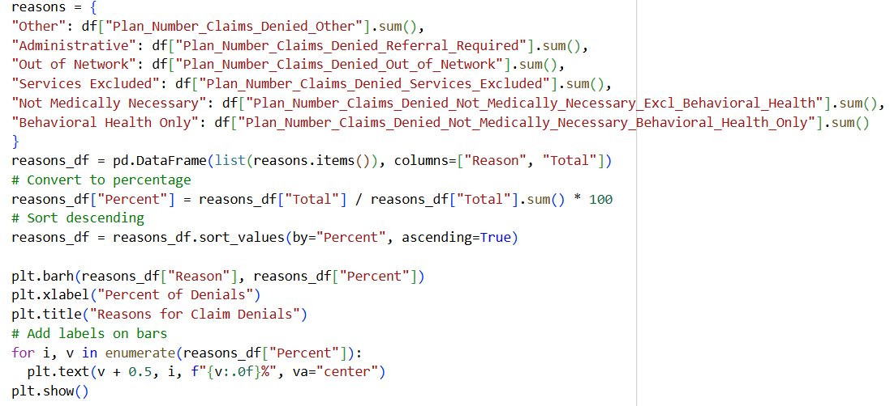
Figure 2 – Proportion of Denial Reasons
This chart shows the distribution of reasons for claim denials across health plans.
I was surprised to find that that “Other” represented a much larger percentage of denial reasons than would be expected in the Industry!

Slide 8
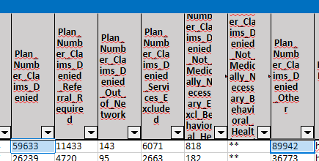
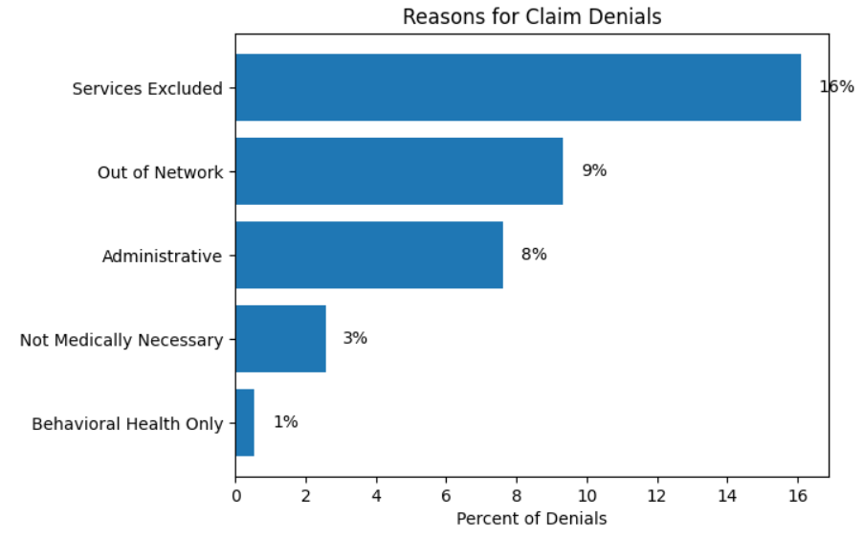
Figure 2 – Proportion of Denial Reasons - Continued
Review of the dataset shows that the “Other” category is disproportionately large
In some cases, “Other” exceeds total denied claims, indicating overlapping or inconsistent classification
This suggests that denial reasons are not mutually exclusive
As a result, including “Other” may distort the distribution of denial reasons

Slide 9
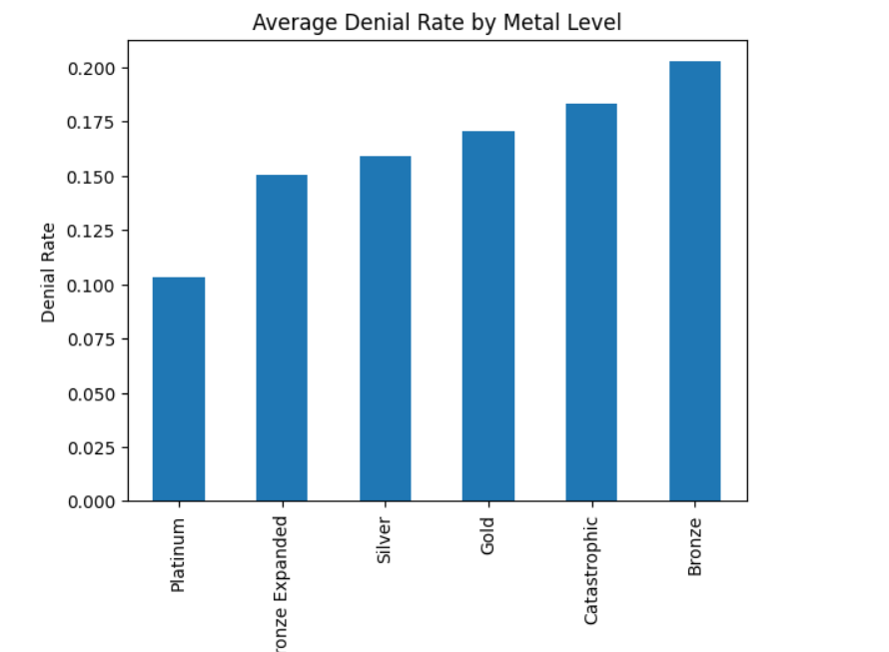

Figure 3
This chart shows the average denial rate by metal level.
Denial rates tend to increase as plan generosity decreases, with Bronze plans having the highest denial rates and Platinum plans the lowest.

Slide 10
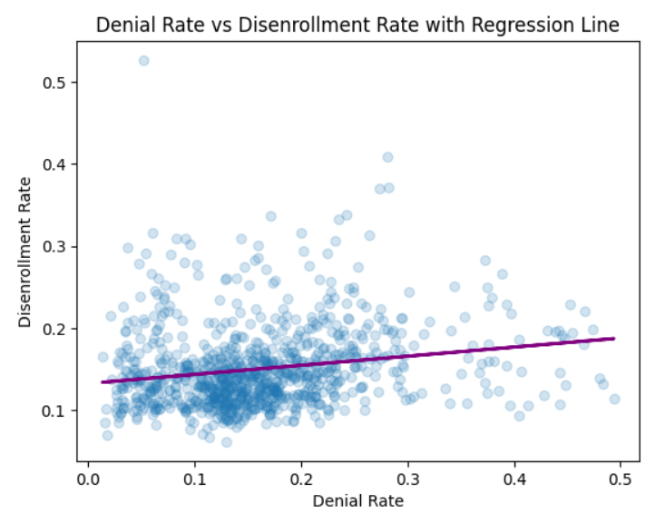
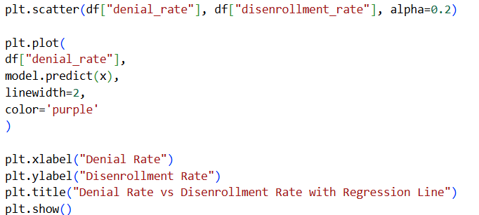
Figure 4
Main Question: Does denial Rate impact enrollment rate?
This chart shows the average denial rate by metal level.
Denial rates tend to increase as plan generosity decreases, with Bronze plans having the highest denial rates and Platinum plans the lowest.

Slide 11
Conclusions
Denial rates vary across issuers and plan types
Higher denial rates are associated with slightly higher disenrollment
The relationship is statistically significant but weak
Denial rates explain only a small portion of consumer behavior
This suggests that other factors play a larger role in influencing whether consumers leave a health plan.
Source Code: https://github.com/huiying8888/data-analytics/blob/main/Capstone/Insurance_Claims_Capstone.ipynb
Dataset Copy: https://github.com/huiying8888/data-analytics/blob/main/Capstone/transparency_in_coverage_PUF_2023.xlsx
Original Dataset: https://data.healthcare.gov/dataset/d722880d-4526-4f54-a87d-e25bdf7891d2

Slide 12
THANKS!
Do you have any questions?
Huiying Lin
La Guardia Data Analytics

